Slide 1

PREDICTION OF AIR QUALITY INDEX USING MACHINE LEARNING
Presented By:
Vasu Bansal. 35311503119
Sayyam Jain 02311503119
Rohan Khilnani 00411503119
Guided By:
Punit Singh Lamba

Slide 2
ABSTRACT
Air pollution is the largest environmental and public health
challenge in the world today. Air pollution leads to adverse effects
on Human health, climate and ecosystem.
Air is getting polluted because of release of Toxic gases by industries, vehicular emissions and increased concentration of harmful gases and particulate matter in the atmosphere.
Particulate matter is one of the most important parameter having the significant contribution to the increase in air pollution.
So in order to prevent us to expose from air pollution we need to predict air quality priorly and take necessary action.

Slide 3
OBJECTIVES
Aim of the Project:
The goal is to develop a machine learning model for real-time air quality forecasting, by comparing the accuracy using supervised machine learning techniques like linear regression, Lasso regression, support vector regression.
Scope of the Project:
The project can be used to monitor the air quality index of a particular area and to predict the air quality and we can try to control the pollutants by taking necessary steps to avoid bad air quality.

Slide 4
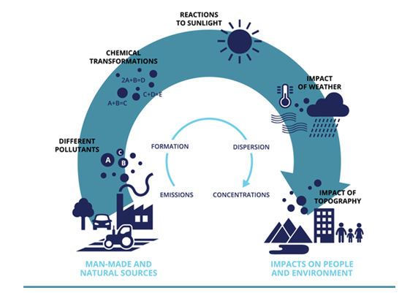
INTRODUCTION
In the last decades, along with the rapid development of the
industrialization and urbanization, the increasing level of air
pollutant concentrations has been a growing rapidly.

Slide 5
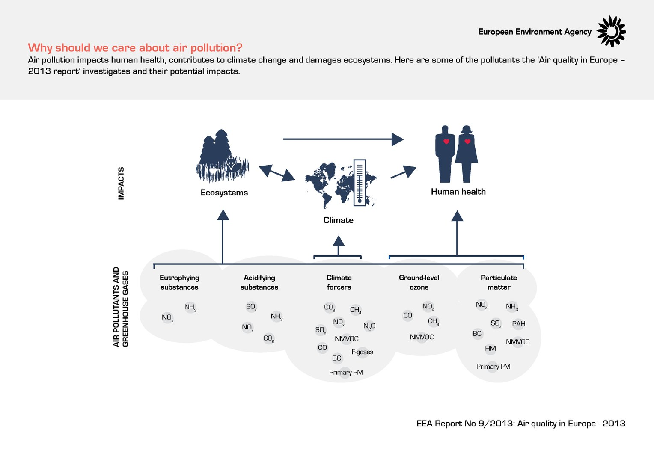
Why should we care about air pollution?

Slide 6
Determinants of PM concentration.
Weather patterns
Wind
Stability (vertical movement of air)
Turbulence
Precipitation
Topography
Smokestack height and temperature of gases

Slide 7
DESIGN AND METHODOLOGIES
MODULE 1:
Data Collection and Processing of the Data
MODULE 2:
Applying the machine learning algorithms

Slide 8
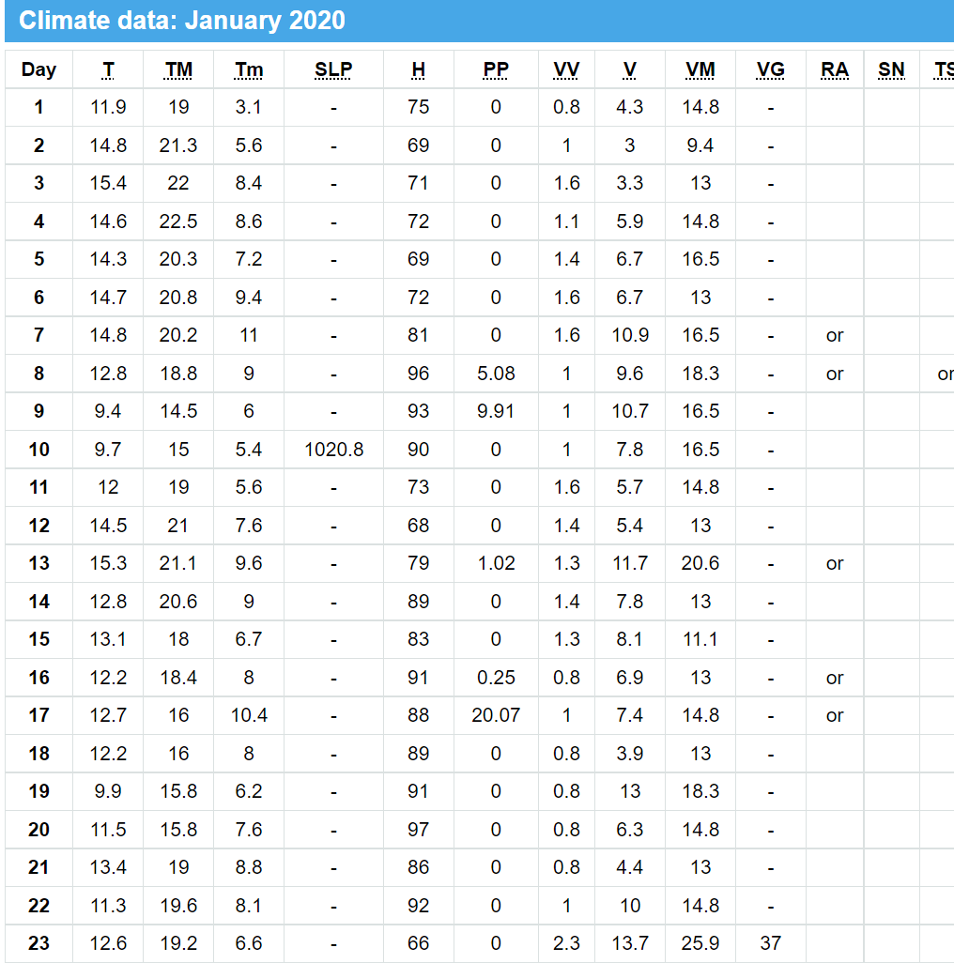
MODULE 1
Data Collection and Processing of data.
Collection Source:-
Weather in New Delhi / Palam during January 2020 - historical climate data (tutiempo.net)

Slide 9
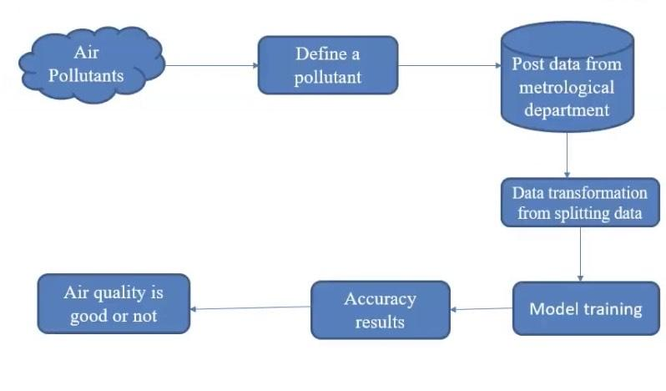
ARCHITECTURE DIAGRAM

Slide 10
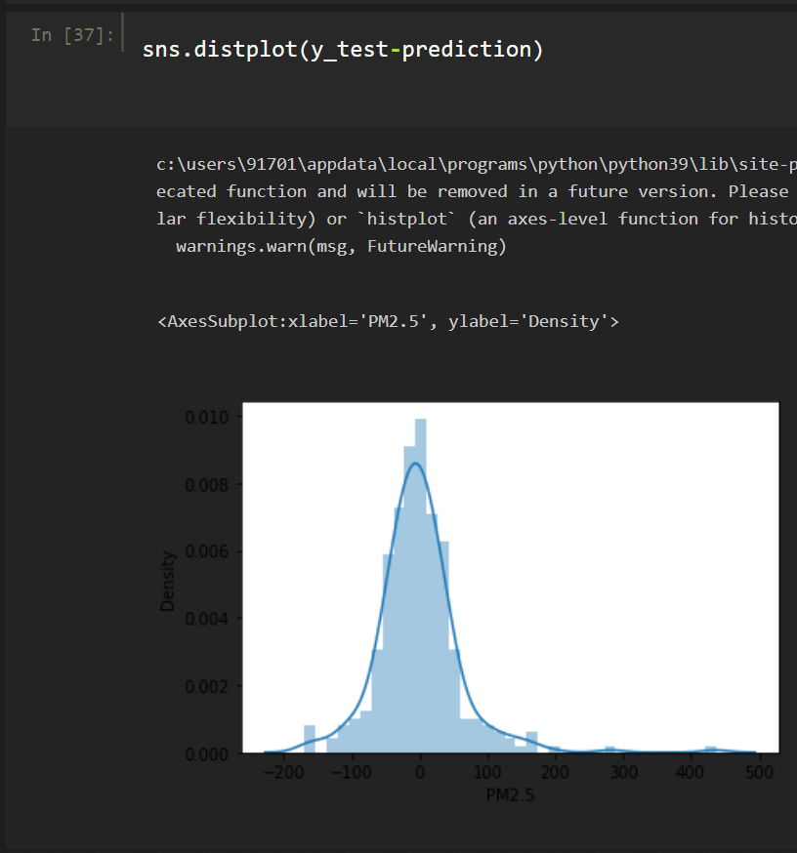

MODULE 2
Training using Machine learning Algorithms.
Data trained using linear regression algorithm.
Cross-validation score calculated and found out to be 0.410357.

Slide 11
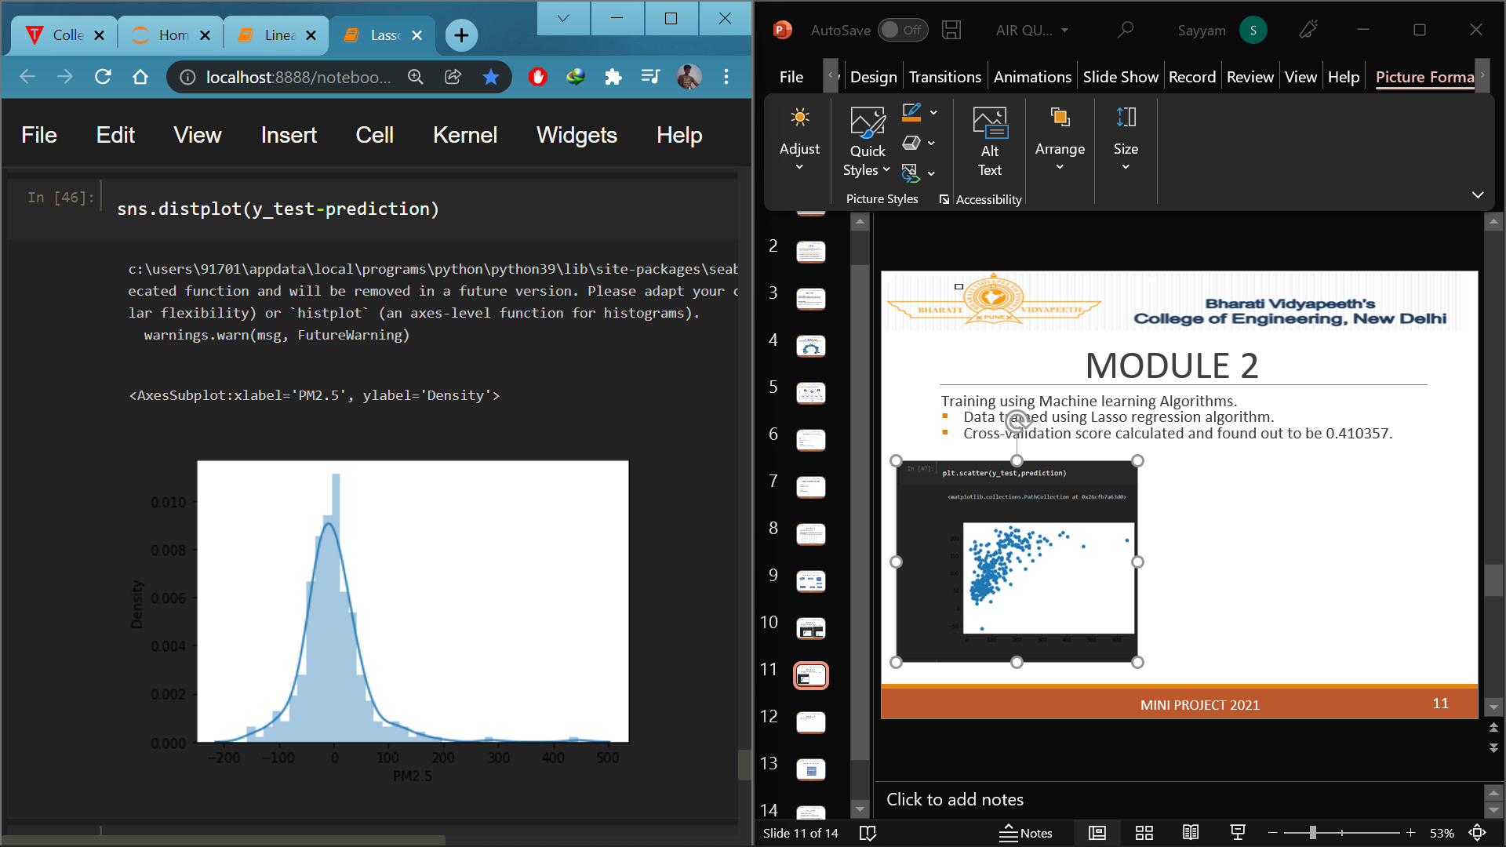
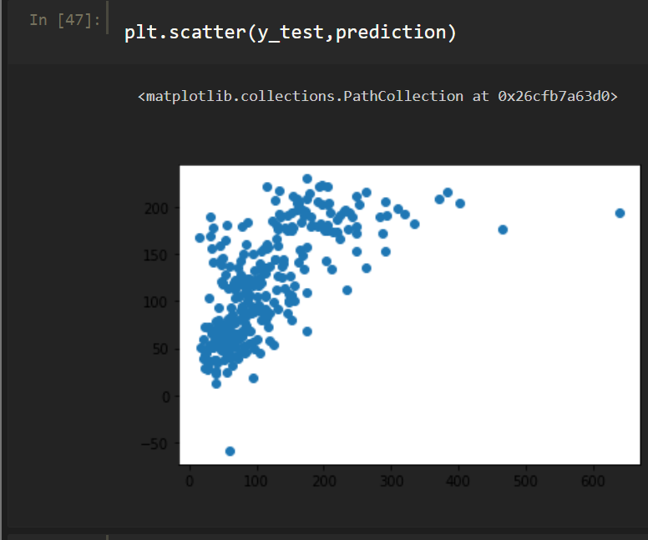
MODULE 2
Training using Machine learning Algorithms.
Data trained using Lasso regression algorithm.

Slide 12
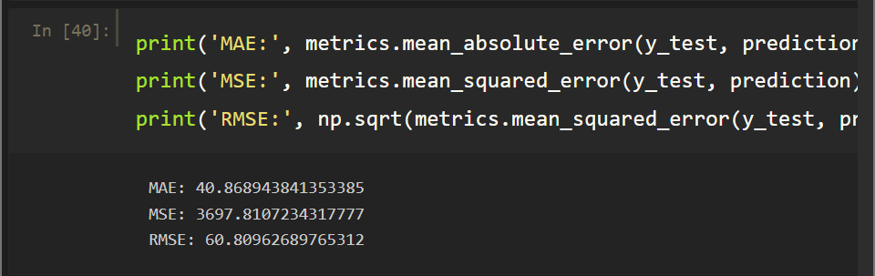

MODULE 2
Training using Machine learning Algorithms.
Three different metrics were calculated.
  Mean Absolute Error
  Mean squared Error
  Root mean squared error.
Linear regression prediction metrics.
Lasso regression prediction metrics.

Slide 13
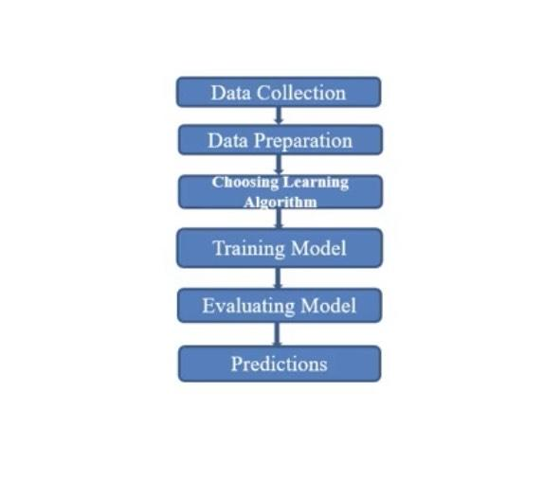
DATA FLOW DIAGRAM

Slide 14
CONCLUSIONS
This study concentrates on the prediction of pollutants present in the air.
Data collection was done, and suitable data analyzed to make the best model for better prediction.
The collected data trained using Linear Regression, and Lasso Regression. Where, Lasso worked better.
There after selective algorithms will be applied on the data and to find the accurate ones for predicting the air quality.

